Slide 1

I always feel like somebody’s Watching me
Practicum Final by Brandi Otto
December 2023

Slide 2
What’s the problem?
By the end of 2021 - 1 billion security cameras in use worldwide (Cosgrove, 2019)
China has the most
US not far behind per capita
Government, Private Companies, Citizens
US citizens encounter
29 cameras on daily commute
40 cameras weekly around workplace. (Melore, 2020)

Slide 3
U.S. Cities with the most cameras
(Lapinyeti, 2023)

Slide 4
Why security Cameras
Becoming less expensive
Better technology
Attitudes changing in younger adults
Gen Z more open to being under surveillance
Greater good/crime reduction
Still a fight against “Big Brother” older generations (Ekins, 2023)

Slide 5
Who’s Not watching
Not enough humans to watch
15% of footage never accessed (Pro-Vigil, 2022)
Less than 1% monitored live (Molkins, 2015)
Employee stealing
Not reported
May not catch until thousands taken
Abduction outside business
How long to be reported, traced to building, accessed by police?
Why it matters

Slide 6
My Question
Can Machine learning help?
Watch
Analyze
Interpret Human Actions
Flag crime
Alert security team for review
Contacts authorities if needed

Slide 7
Angle of Attack
Dataset from University of Central Florida’s Center for Research in Computer Vision
Crime Dataset
1900 videos/13 classes
Reduced to 650 videos/9 classes
No Crime
Burglary
Explosion
Fighting
Robbery
Shooting
Shoplifting
Stealing
Vandalism

Slide 8
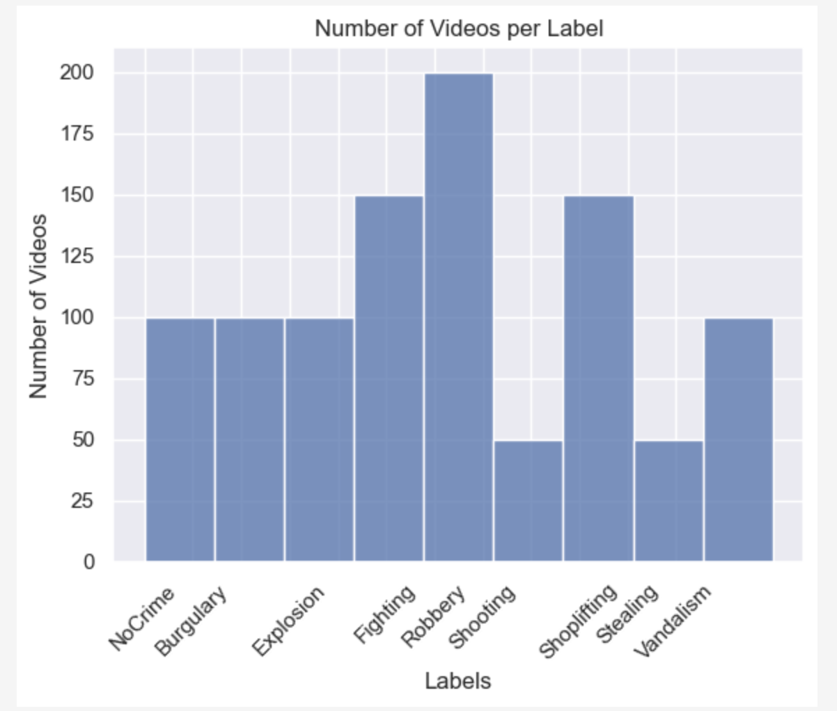
Dataset Breakdown
Dataset may be skewed towards Robbery, Fighting, and Shoplifting

Slide 9
Cleaning the data
Extract Frames
Reshape and Normalize
Test for threshold to filter frames
Logos
All black or white frames
Convert back to RGB color channel format

Slide 10
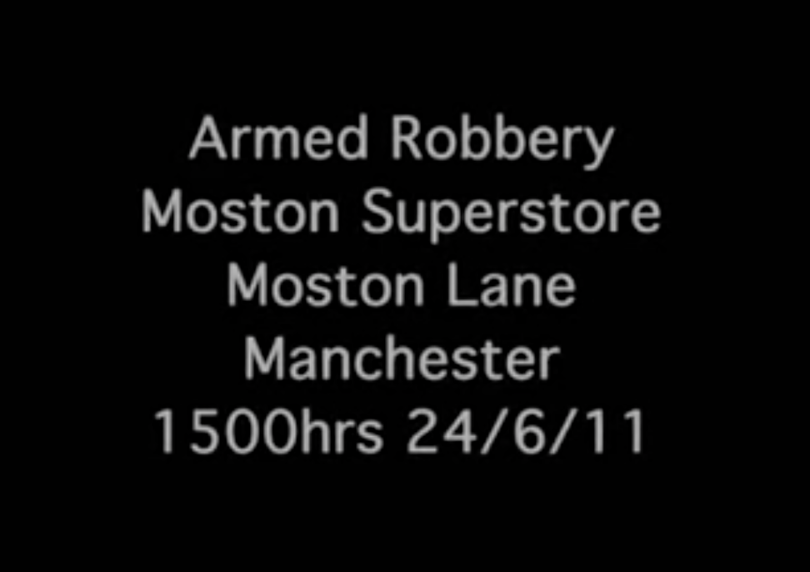
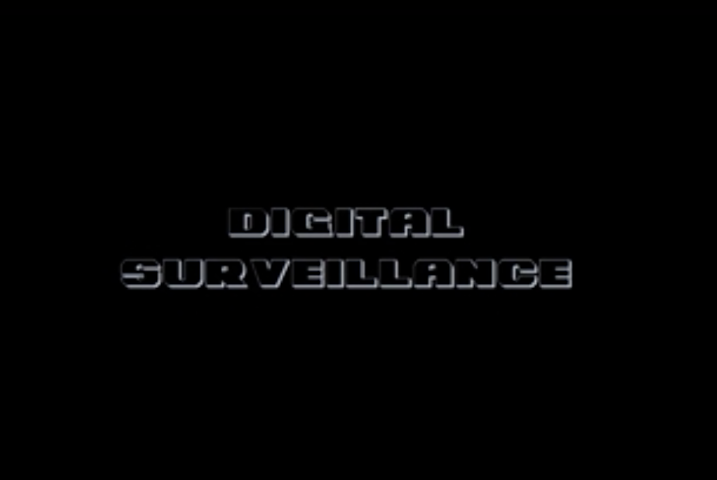
frames discarded by threshold filter
Robbery Frame
Shoplifting Frame

Slide 11
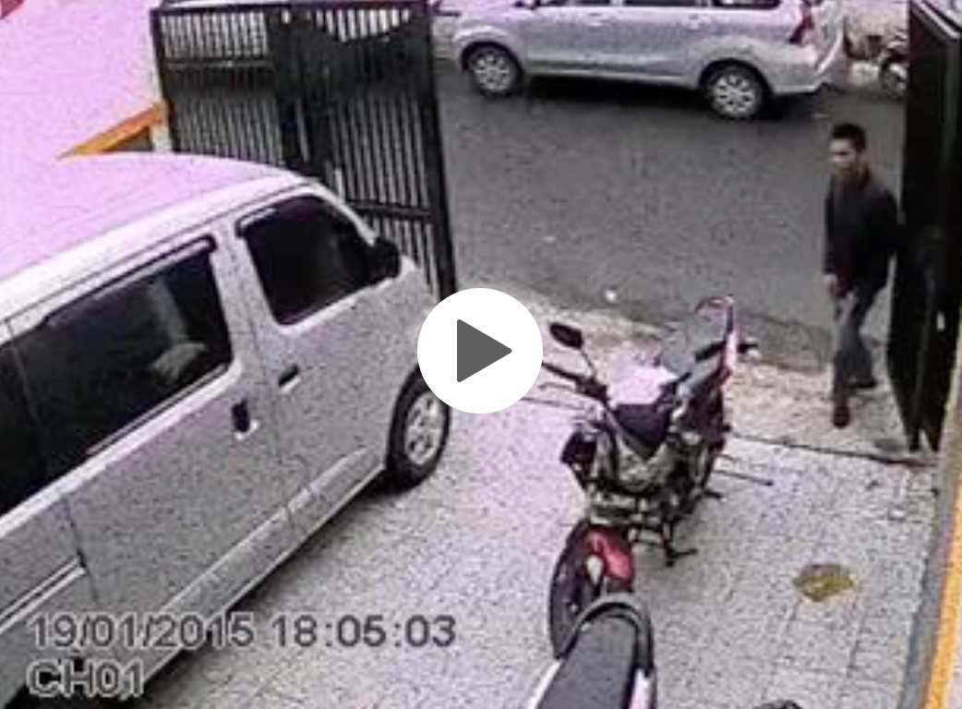
Video
From
Stealing
Category

Slide 12
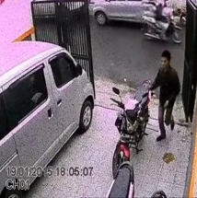
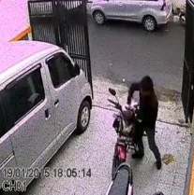
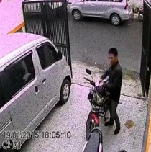
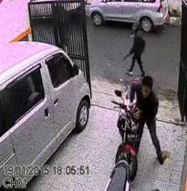
Frames Accepted in Extraction Process

Slide 13
ConvLstm2d Model
Convolutional Neural Networks best for images
Detects edges and patterns in images
LSTM models are best for time sequence items such as text analysis
Preserves importance of the sequence of action
Examples include Human Action Recognition(sports) and movie genre detections

Slide 14
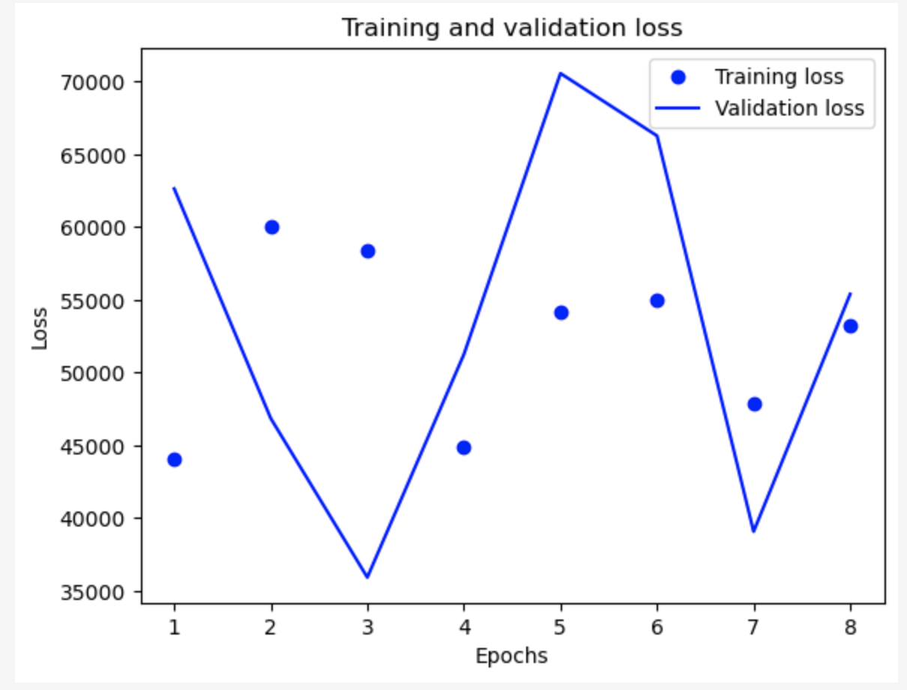
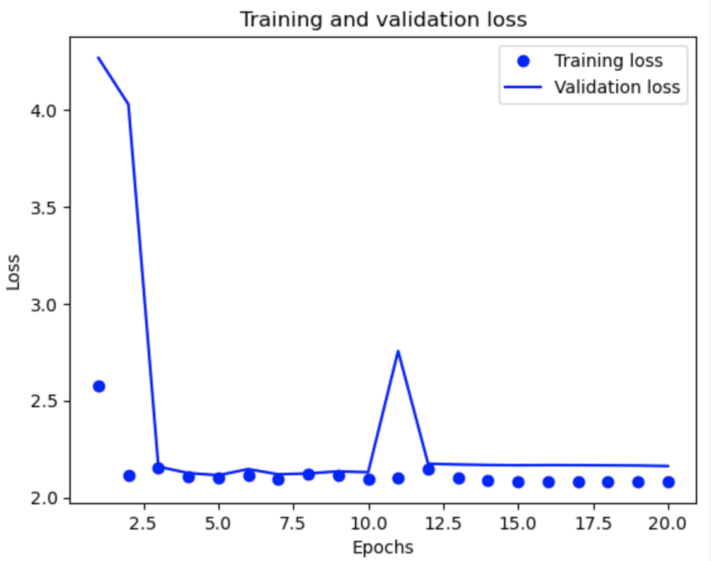
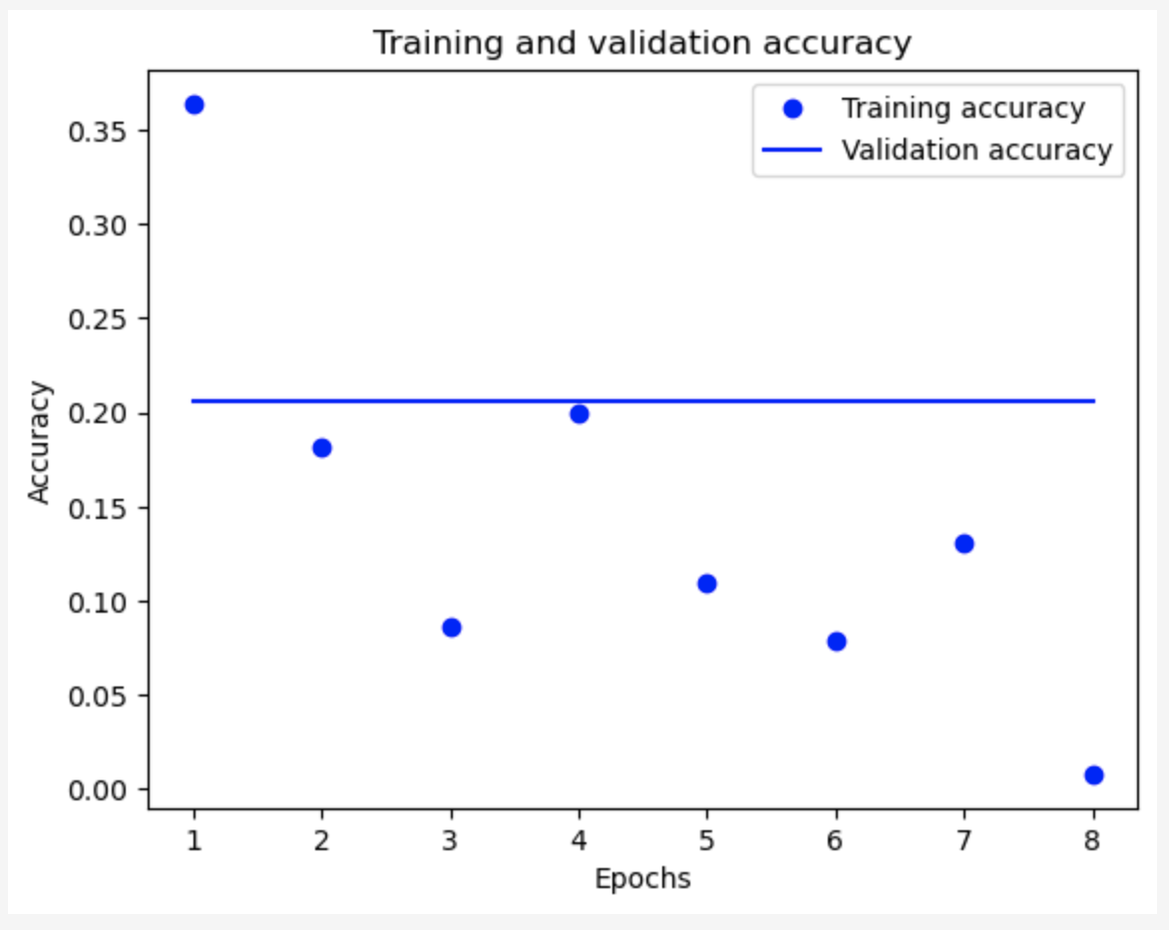
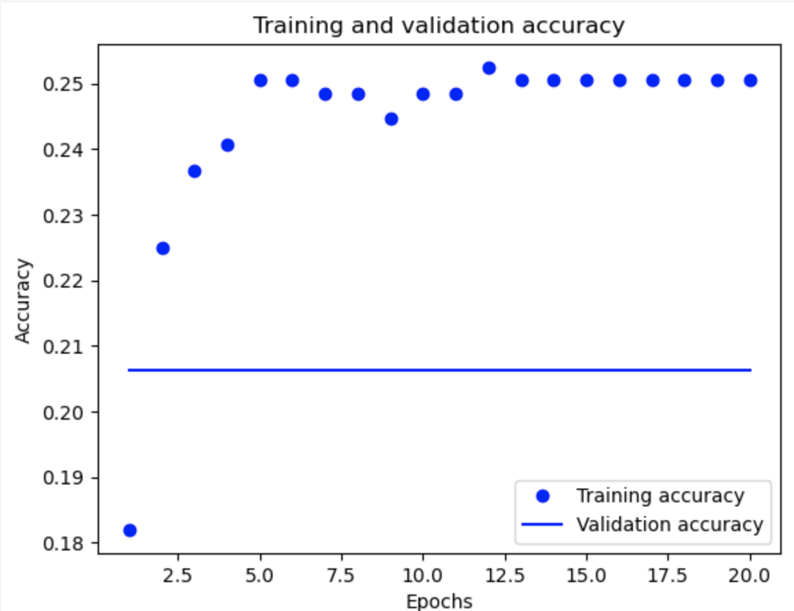
Model Performance
Model #1
Model #5
Focused on tuning
Filters
Regulators
Batch Size
Epochs
Shuffle of data
into model

Slide 15
Conclusions
My test accuracy never rose over 20%
Even after running longer model
It would not have trained better
Improvements:
Shorten Videos
Focus on action
Combine or edit similar categories
Robbery, Burglary, Shoplifting, Stealing
Could be the wrong model

Slide 16
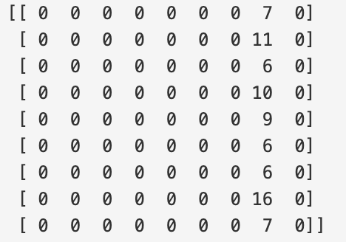
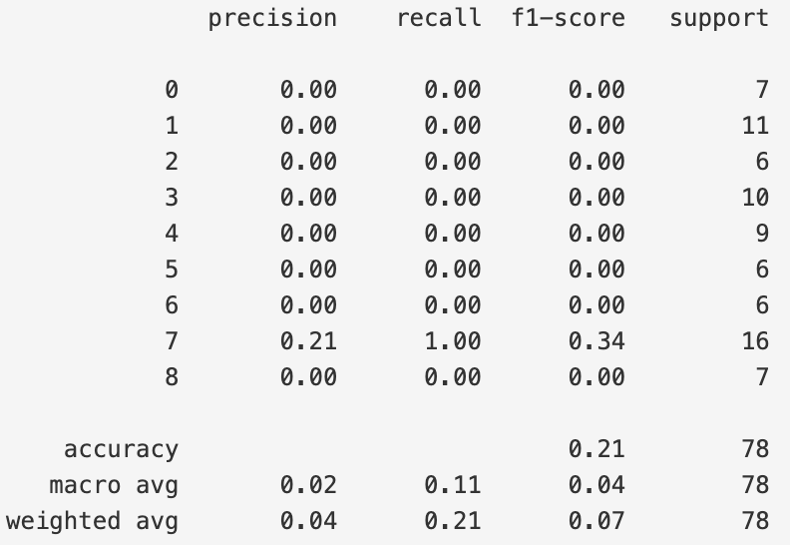
Confusion Matrix & Classification Report
Model #5
It looks like the model is
picking only one label: Stealing
Which is weird because one of
lowest number of videos in dataset

Slide 17
To the Future
The goal is to develop a model to run locally for mid to large size businesses
Computationally and Monetarily effective
Preprocess videos differently
Try a pretrained model such as ResNet50

Slide 18
References:
Brownlee, J. (2020). How to Tune LSTM Hyperparameters with Keras for Time Series Forecasting. https://machinelearningmastery.com/tune-lstm-hyperparameters-keras-time-series-forecasting/
Cosgrove, E. (2019, December 6). One billion surveillance cameras will be watching around the world in 2021, a new study says. CNBC. https://www.cnbc.com/2019/12/06/one-billion-surveillance-cameras-will-be-watching-globally-in-2021.html
Ekins, E., & Gygi, J. (2023, June 1). Nearly a Third of Gen Z Favors the Government Installing Surveillance Cameras in Homes. https://www.cato.org/blog/nearly-third-gen-z-favors-home-government-surveillance-cameras-1
Gert Molkins. (2015, August 19). Live video monitoring usage statistics. IPVM. https://ipvm.com/reports/live-video-monitoring-usage-statistics
Kumar, K. (2023, March 29). Getting to know adam optimization: A comprehensive guide. https://www.linkedin.com/pulse/getting-know-adam-optimization-comprehensive-guide-kiran-kumar
Lapienytė, J. (2023). This is the most heavily surveilled city in the US. https://cybernews.com/editorial/this-is-the-most-heavily-surveilled-city-in-the-us-50-cctv-cameras-per-1000-citizens/
Melore, C. (2020, September 24). Average American recorded by security cameras 238 times each week. Study Finds. https://studyfinds.org/americans-security-cameras-study/
Pro-Vigil. (2022, March 24). 15% of businesses never check their camera footage – and that’s a problem. Pro-Vigil Video Surveillance. https://pro-vigil.com/blog/15-of-businesses-never-check-their-camera-footage-and-thats-a-problem/
Xavier, A. (2019, April 22). An introduction to ConvLSTM. Neuronio. https://medium.com/neuronio/an-introduction-to-convlstm-55c9025563a7
Dataset obtained from the University of Central Florida's Center for Research in Computer Vision: https://www.crcv.ucf.edu/projects/real-world/

